Slide 1
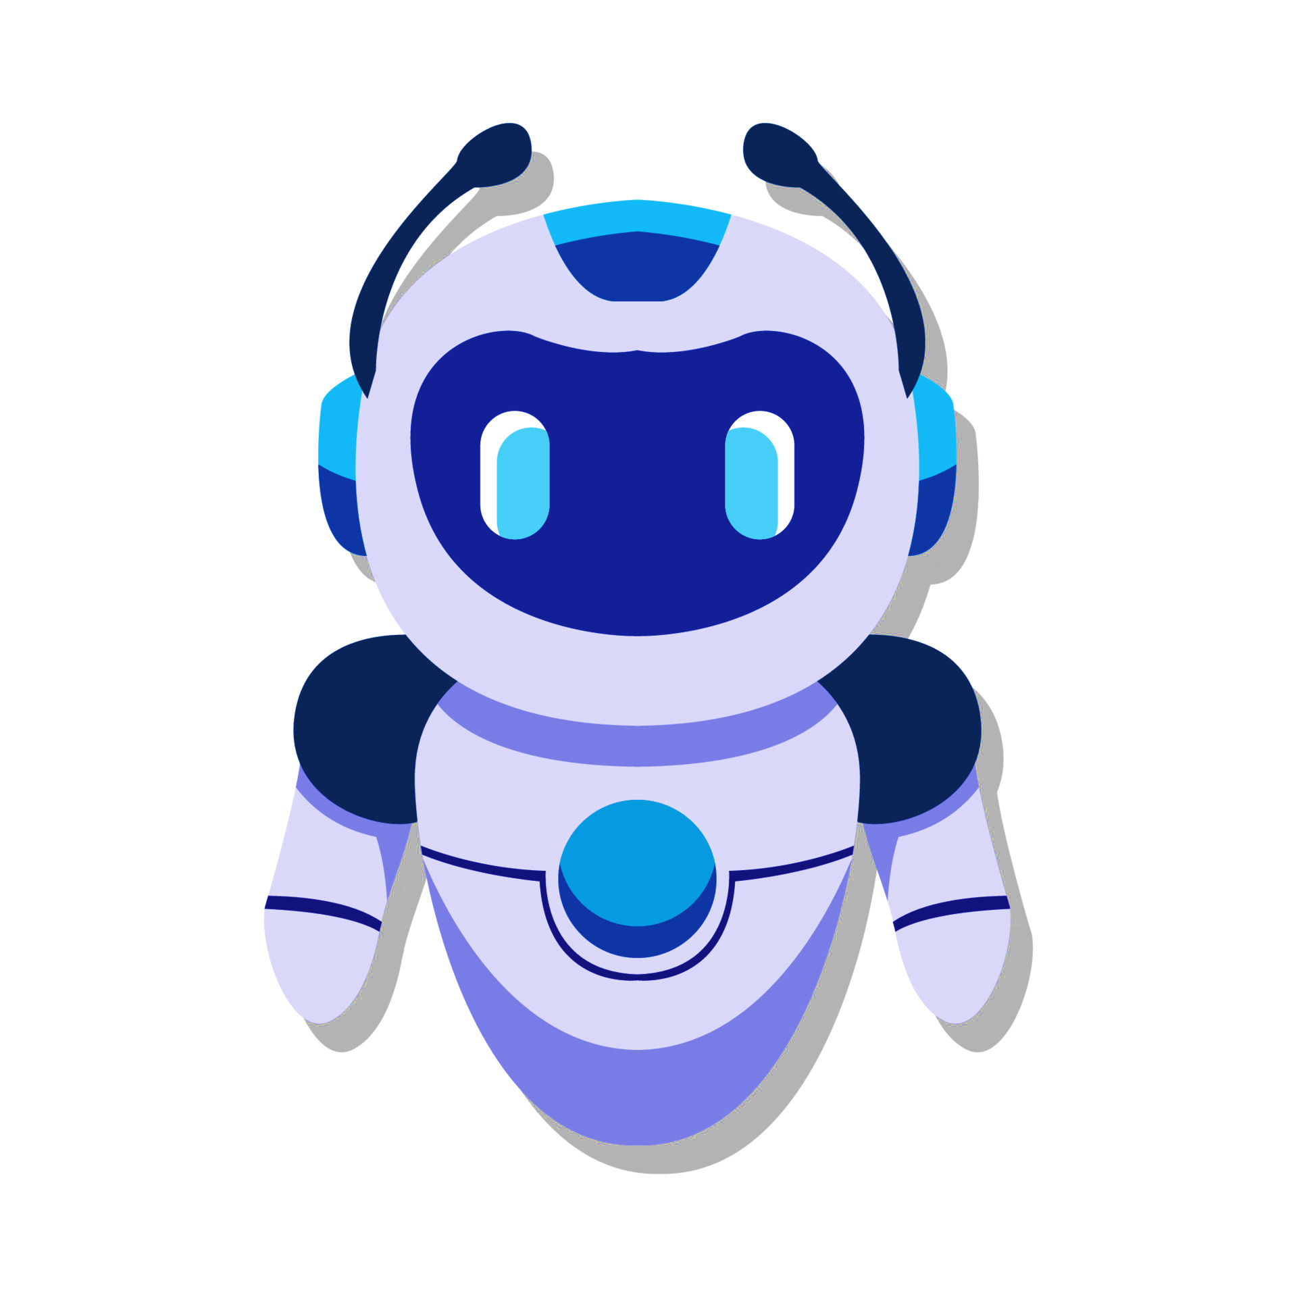
Medical chatbot
AP21110010791 M.Sree annapurna
AP21110010794 B.Jyothirmai
AP21110010798 G.Madhurya
AP21110010829 M.Nandita

Slide 2
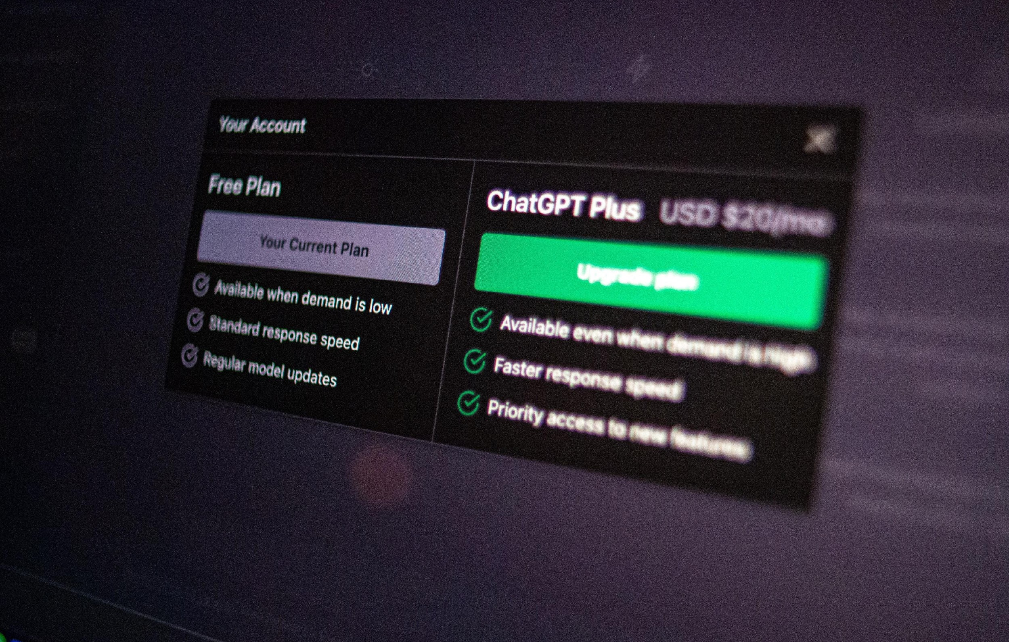
A medical chatbot is a computer program designed to simulate conversations with users in the context of healthcare and medicine. These chatbots can provide information, answer questions, offer recommendations, and even assist with basic diagnosis or symptom checking based on the input they receive from users.

Slide 3
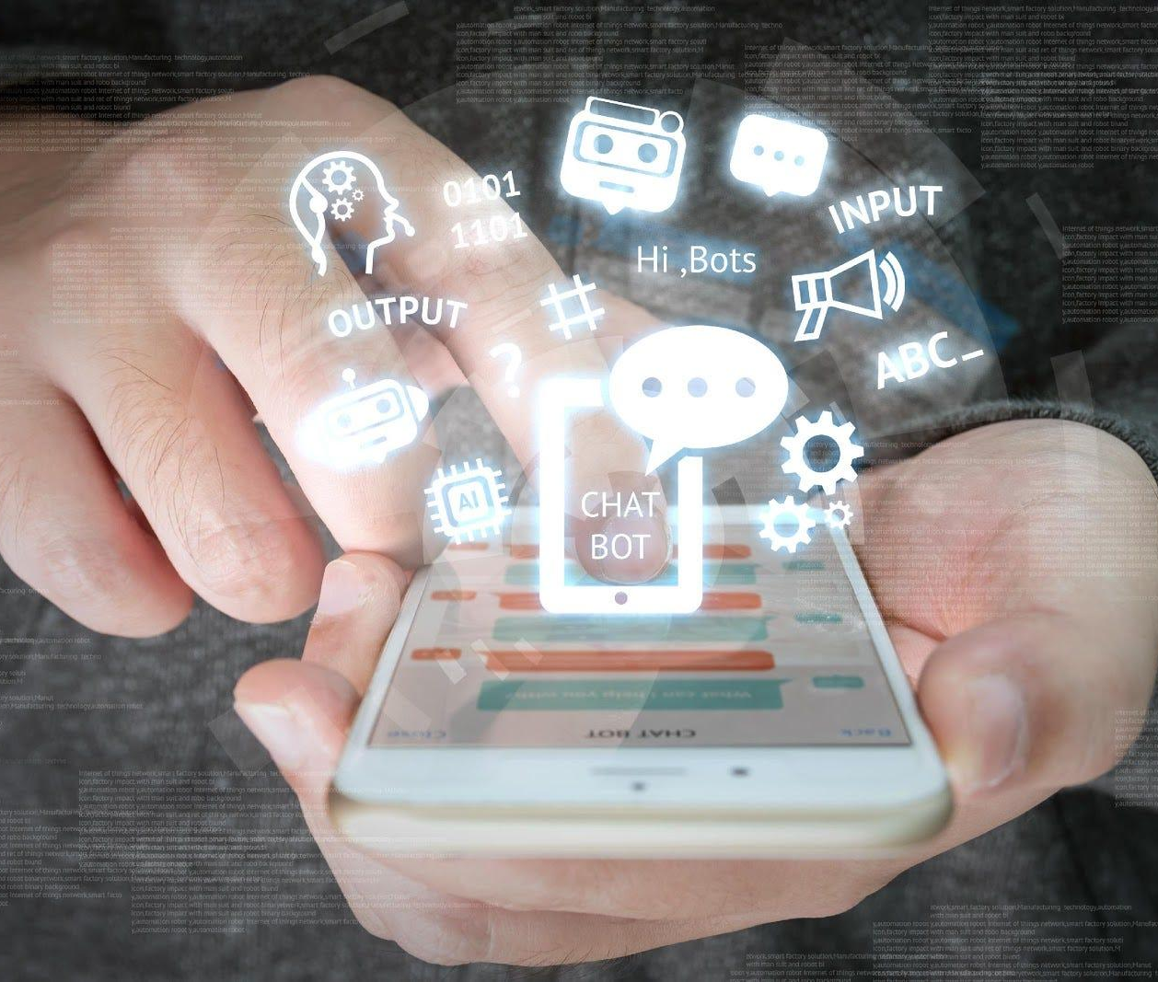


Introduction
A medical chatbot is an AI-powered conversational agent that leverages natural language processing and machine learning technologies to assist users with health-related queries, provide information about diseases, symptoms, treatments, and preventive measures. By engaging in natural language conversations, these chatbots can guide users through symptom analysis, offer disease-specific details, recommend preventive measures, and suggest appropriate medical consultations when necessary, acting as a virtual medical assistant. While not intended to replace professional medical advice or diagnoses, medical chatbots can serve as valuable tools for initial symptom evaluation, health education, and triage, potentially improving access to medical information and reducing the burden on healthcare systems.
PAGE
‹#›

Slide 4
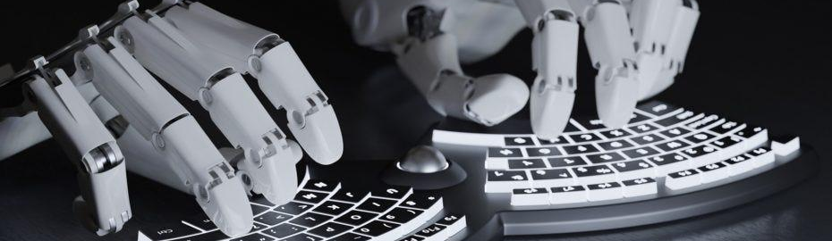
How Chatbots Typically Work
01
02
03
User Input:
Natural Language Processing:
Intent Recognition:
Users interact with the chatbot by typing or speaking natural language input, asking questions, or making requests.
NLP is a key component of chatbot functionality. It involves the ability of the chatbot to understand and interpret human language.
Once the chatbot has processed the user input, it identifies the user's intent—what the user is trying to accomplish or inquire about.

Slide 5
How Chatbots Typically Work
04
05
06
07
Dialog Management
Query Processing
Delivery of Response
Integration with External Systems
Smart chatbots maintain context, recalling past interactions for improved, coherent responses in communication.
Chatbot interprets user intent, extracts entities, and fetches data from databases, APIs, or knowledge bases.
Chatbot responds via platform interface—messaging app, website, or other channels, facilitating user interaction seamlessly.
Chatbot integrates with external systems for tasks, real-time data retrieval using databases, or APIs.

Slide 6
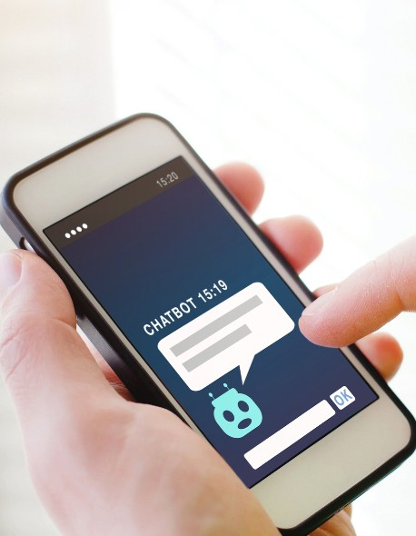
Features
24/7 Availability: Medical chatbots are available around the clock, providing patients with instant access to medical assistance whenever they need it.
Fast Response Time: With AI technology, medical chatbots can answer questions much faster than a human
Personalized Care: Medical chatbots provide patients with a non-judgmental and private way to share medical information, allowing them to feel more comfortable discussing sensitive topics.

Slide 7
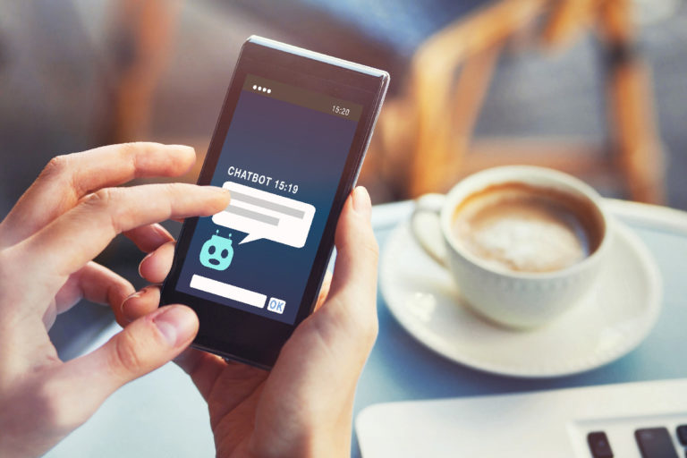
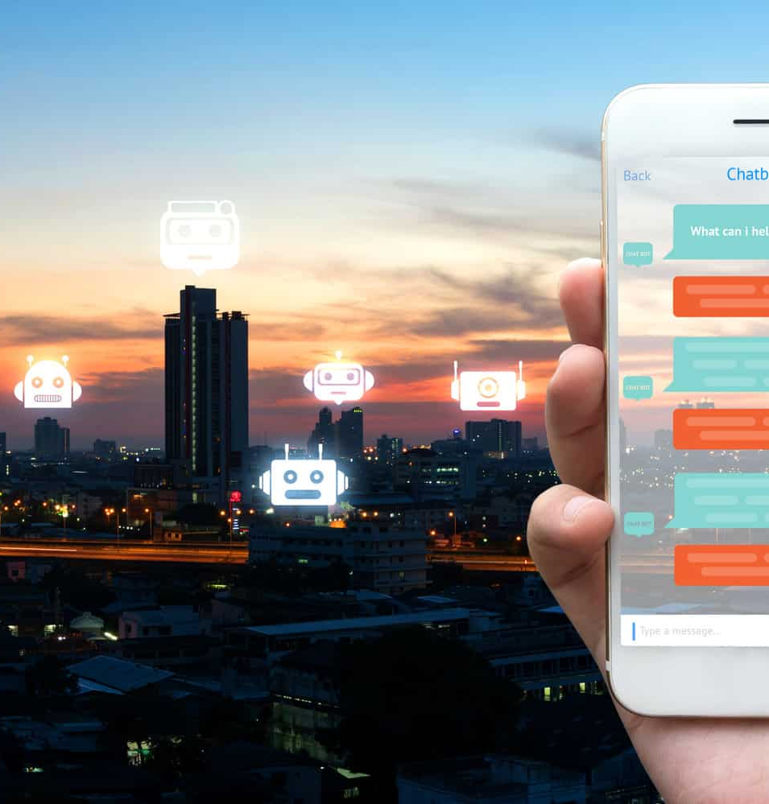
software and hardware requirements
Software Requirements
• PHP (front end)
• HTML
• JavaScript
• MS Word 97 or later
• Web Browser: Microsoft Internet Explorer, Mozilla, Google Chrome or later
• python
• Operating System: Windows XP / Windows7/ Windows Vista
Hardware Requirements
• Pentium IV or higher, (PIV-300GHz recommended)
• 256 MB RAM
• 1 Gb hard free drive space
Server Required
• Four 2.8 GHz core processors
• 16 GB of RAM
• 10 GB of hard disk space

Slide 8
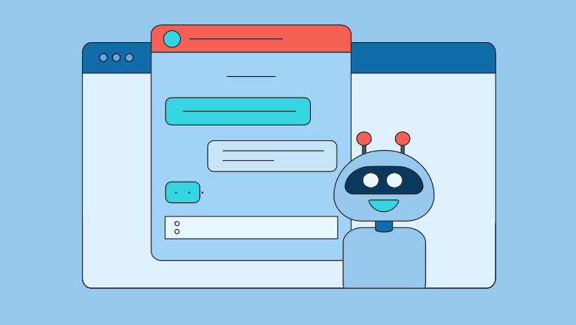
Libraries used
Based on the provided code, the following libraries are used in the medical chatbot Flask application:
Flask: This is the Python web framework used to build the chatbot application.
NumPy: A fundamental package for scientific computing with Python, used for numerical operations and data manipulation.
Pandas: A powerful data analysis and manipulation library for Python, used to load and preprocess the datasets (symptoms, diseases, descriptions, precautions, medications, diets, and workouts).
Pickle: A Python module used for serializing and deserializing Python objects, employed in this application to load the pre-trained machine learning model.
While not explicitly shown in the provided code, the application likely utilizes additional libraries, such as:
Scikit-learn: A widely-used machine learning library for Python, potentially used for training and implementing the disease prediction model.
Natural Language Toolkit (NLTK) or SpaCy: Libraries for natural language processing tasks, which could be employed for processing and understanding user input (symptoms).

Slide 9
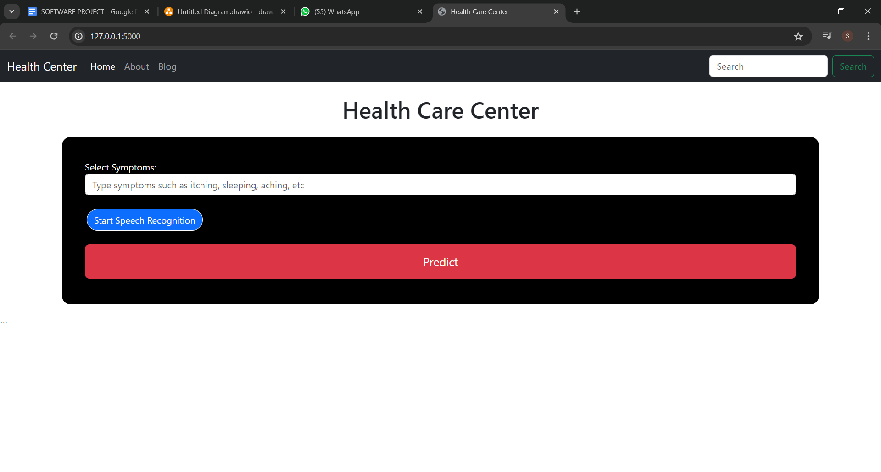
Output

Slide 10
limitations,future scope
Limitations :
Limited Dataset: The medical chatbot system relies on a predefined dataset of symptoms, diseases, precautions, medications, diets, and workouts. This dataset may not cover all possible medical conditions or scenarios, limiting the chatbot ability to provide accurate information and recommendations in certain cases.
Lack of Real-time Updates: The current implementation does not include a mechanism for updating the knowledge base with the latest medical information or research findings. As medical knowledge evolves rapidly, the chatbot may become outdated over time, potentially providing inaccurate or obsolete information.
Limited Natural Language Processing: While the chatbot can interpret user input in the form of symptoms, it may struggle with more complex or ambiguous natural language queries, limiting its ability to understand and respond appropriately to users' questions or concerns.
future scope :
Expanding the Knowledge Base: Continuously updating and expanding the knowledge base with the latest medical information, research findings, and treatment guidelines can significantly improve the chatbot's accuracy and relevance.
Improving Natural Language Processing: Incorporating advanced natural language processing techniques, such as deep learning models or contextual language understanding, can enhance the chatbot's ability to comprehend and respond to more complex and nuanced user queries

Slide 11
Conclusion
The medical chatbot Flask application provides a convenient and accessible way for users to obtain information about diseases, precautions, medications, diets, and workouts based on their reported symptoms. However, it is essential to acknowledge the limitations of the current implementation, such as the reliance on a predefined dataset, lack of real-time updates, limited natural language processing capabilities, and the inability to provide personalized treatment plans or perform actual medical diagnoses.
To address these limitations and improve the chatbot's effectiveness, future efforts should focus on expanding and continuously updating the knowledge base, integrating with electronic health records and diagnostic tools, enhancing natural language processing capabilities, and incorporating telemedicine features. Additionally, improving the user experience through a more intuitive interface and multimedia content could increase user engagement and satisfaction.
It is important to note that while the medical chatbot can serve as a valuable information resource and provide general recommendations, it should not be considered a substitute for professional medical advice or treatment. Users should always consult with qualified healthcare professionals for accurate diagnoses and personalized treatment plans.
Overall, the medical chatbot Flask application demonstrates the potential of leveraging technology to provide accessible and convenient medical information to users. With continuous improvements and integration with advanced medical systems, such chatbots can become powerful tools to support healthcare delivery and empower individuals to better understand and manage their health.

